Slide 1


Inferences
Inferring is explaining or interpreting an observation. Inferences must make sense.

Slide 2
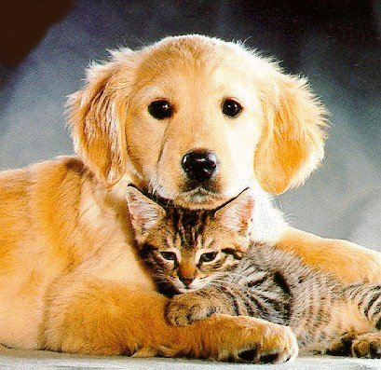
What can you Infer from these Pictures

Slide 4
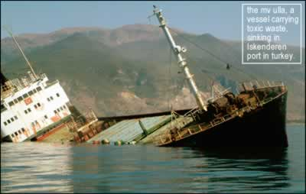

Slide 5
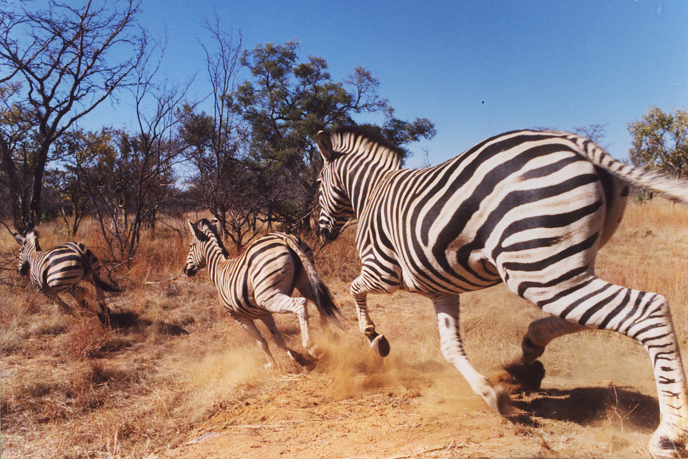

Slide 6
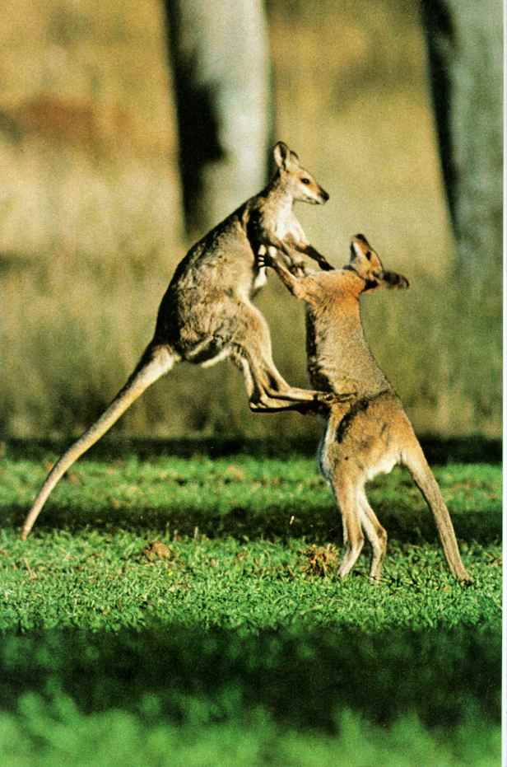

Slide 7


